Slide 1

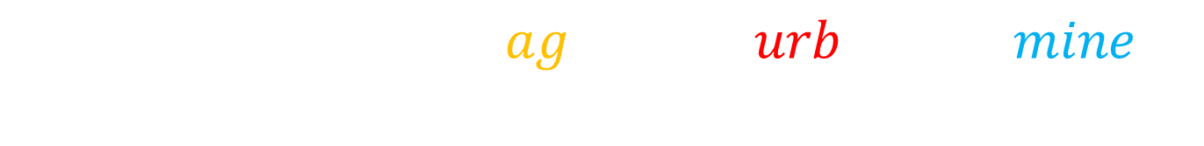




“Simple” model
$$y_{ij}\sim bern(p_{ij}z_{i})$$
Data
$${logit(p}_{ij})=α_{0}+α_{1}{(Effort)}_{i}+α_{2}{({Srvy}_{2})}_{j}$$
$$+α_{3}{({Srvey}_{3})}_{j}$$
$$z_{i}\sim bern(ψ_{i})$$
Process
$${logit(ψ}_{i})=β_{0}+β_{1}{(ag)}_{i} + β_{2}{(urb)}_{i}+ β_{3}{(mine)}_{i}$$
$$+β_{4}{(veg)}_{i}+β_{5}{(size)}_{i}+β_{6}{(isol)}_{i}$$
$α_{l}\sim N(0,σ_{α}^{2})$, l = 0,…,3
Parameter
$β_{k}\sim N(0,σ_{β}^{2})$, k = 0,…,6

Slide 2

“Simple” model
$$y_{ij}\sim bern(p_{ij}z_{i})$$
Data
$${logit(p}_{ij})=α_{0}+α_{1}{(Effort)}_{i}+α_{2}{(Date)}_{j}$$
$$z_{i}\sim bern(ψ_{i})$$
Process
$${logit(ψ}_{i})=β_{0}+β_{1}{(ag)}_{i} + β_{2}{(urb)}_{i}+ β_{3}{(mine)}_{i}$$
$$+β_{4}{(veg)}_{i}+β_{5}{(size)}_{i}+β_{6}{(isol)}_{i}$$
$α_{l}\sim N(0,σ_{α}^{2})$, l = 0,…,3
Parameter
$β_{k}\sim N(0,σ_{β}^{2})$, k = 0,…,6

Slide 3





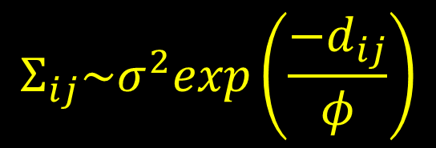
“Spatial” model
$$y_{ij}\sim bern(p_{ij}z_{i})$$
Data
$${logit(p}_{ij})=α_{0}+α_{1}{(Effort)}_{j}+α_{2}{({Srvy}_{2})}_{j}$$
$$+α_{3}{({Srvey}_{3})}_{j}$$
$$z_{i}\sim bern(ψ_{i})$$
Process
$${logit(ψ}_{i})=β_{0}+β_{1}{(ag)}_{i} + β_{2}{(urb)}_{i}+ β_{3}{(mine)}_{i}$$
$$+β_{4}{(veg)}_{i}+β_{5}{(size)}_{i}+β_{6}{(isol)}_{i}+ ε_{i}$$
$α_{l}\sim N(0,σ_{α}^{2})$, l = 0,…,3
$$ε_{i}\sim N(0,Σ)$$
Parameter
$$Σ_{ij}\sim σ^{2}exp\left(\frac{−d_{ij}}{φ}\right)$$
$β_{k}\sim N(0,σ_{β}^{2})$, k = 0,…,6

Slide 4

“Spatial” model
$$y_{ij}\sim bern(p_{ij}z_{i})$$
Data
$${logit(p}_{ij})=α_{0}+α_{1}{(Effort)}_{j}+α_{2}{(Date)}_{j}$$
$$z_{i}\sim bern(ψ_{i})$$
Process
$${logit(ψ}_{i})=β_{0}+β_{1}{(ag)}_{i} + β_{2}{(urb)}_{i}+ β_{3}{(mine)}_{i}$$
$$+β_{4}{(veg)}_{i}+β_{5}{(size)}_{i}+β_{6}{(isol)}_{i}+ ε_{i}$$
$α_{l}\sim N(0,σ_{α}^{2})$, l = 0,…,3
$$ε_{i}\sim N(0,Σ)$$
Parameter
$$Σ_{ij}\sim σ^{2}exp\left(\frac{−d_{ij}}{φ}\right)$$
$β_{k}\sim N(0,σ_{β}^{2})$, k = 0,…,6

Slide 5


Relationships within and among landscapes may affect occupancy
$$Σ_{ii′}\sim σ^{2}exp\left(\frac{−d_{ii′}}{φ}\right)$$
$$Σ_{ii′}$$
1 km
d_{ii’}

Slide 6

$$Σ_{ii′}\sim σ^{2}exp\left(\frac{−d_{ii′}}{φ}\right)$$
$$Σ_{ii′}$$
Once the landscape effects are accounted for, we expect any remaining spatial structure to occur at the sub-landscape scale
1 km
d_{ij}

Slide 7




$$Σ_{ii′}\sim σ^{2}exp\left(\frac{−d_{ii′}}{φ}\right)$$
Priors for σ² and φ:
$σ^{2}\sim IG$(r, g)
$$Σ_{ij}$$
φ = fixed = 300m
or
$$log⁡(φ)\sim N(μ_{φ},σ_{φ}^{2})$$
1 km
D_{ii’}

Slide 8


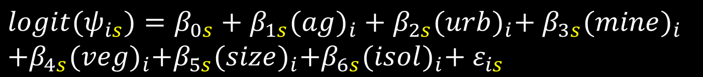

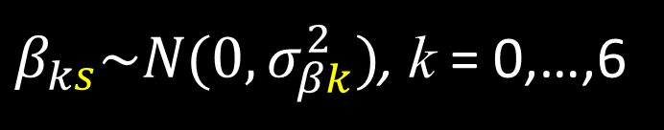
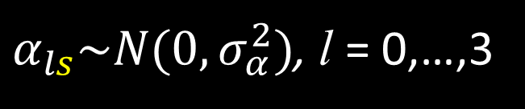
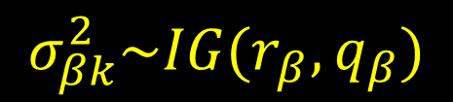
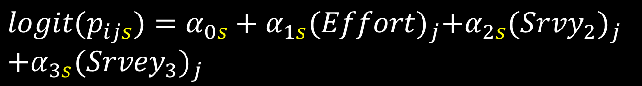

“Multispecies” model
$$y_{ijs}\sim bern(p_{ijs}z_{is})$$
Data
$${logit(p}_{ijs})=α_{0s}+α_{1s}{(Effort)}_{j}+α_{2s}{({Srvy}_{2})}_{j}$$
$$+α_{3s}{({Srvey}_{3})}_{j}$$
$$z_{is}\sim bern(ψ_{i})$$
Process
$${logit(ψ}_{is})=β_{0s}+β_{1s}{(ag)}_{i} + β_{2s}{(urb)}_{i}+ β_{3s}{(mine)}_{i}$$
$$+β_{4s}{(veg)}_{i}+β_{5s}{(size)}_{i}+β_{6s}{(isol)}_{i}+ ε_{is}$$
$$ε_{is}\sim N(0,Σ)$$
$α_{ls}\sim N(0,σ_{α}^{2})$, l = 0,…,3
$$Σ_{ii′}\sim σ^{2}exp\left(\frac{−d_{ii′}}{φ}\right)$$
Parameter
$β_{ks}\sim N(0,σ_{βk}^{2})$, k = 0,…,6
$$σ_{βk}^{2}\sim IG(r_{β},q_{β})$$

Slide 9


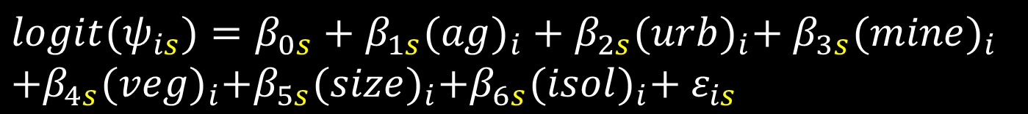

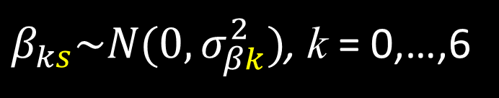
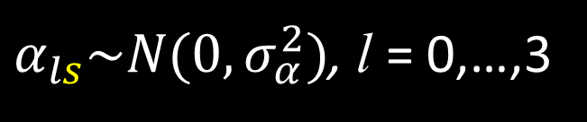
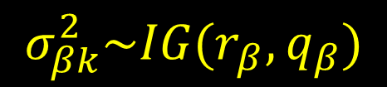

“Multispecies” model
$$y_{ijs}\sim bern(p_{ijs}z_{is})$$
Data
$${logit(p}_{ijs})=α_{0s}+α_{1s}{(Effort)}_{j}+α_{2s}{(Date)}_{j}$$
$$z_{is}\sim bern(ψ_{i})$$
Process
$${logit(ψ}_{is})=β_{0s}+β_{1s}{(ag)}_{i} + β_{2s}{(urb)}_{i}+ β_{3s}{(mine)}_{i}$$
$$+β_{4s}{(veg)}_{i}+β_{5s}{(size)}_{i}+β_{6s}{(isol)}_{i}+ ε_{is}$$
$$ε_{is}\sim N(0,Σ)$$
$α_{ls}\sim N(0,σ_{α}^{2})$, l = 0,…,3
$$Σ_{ii′}\sim σ^{2}exp\left(\frac{−d_{ii′}}{φ}\right)$$
Parameter
$β_{ks}\sim N(0,σ_{βk}^{2})$, k = 0,…,6
$$σ_{βk}^{2}\sim IG(r_{β},q_{β})$$

Slide 10
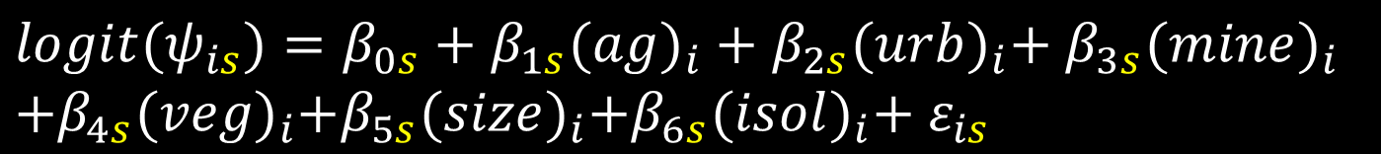
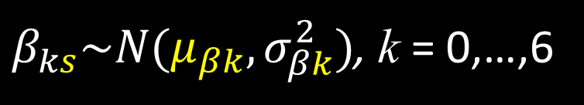
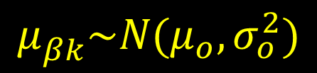

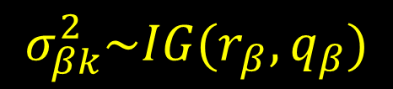
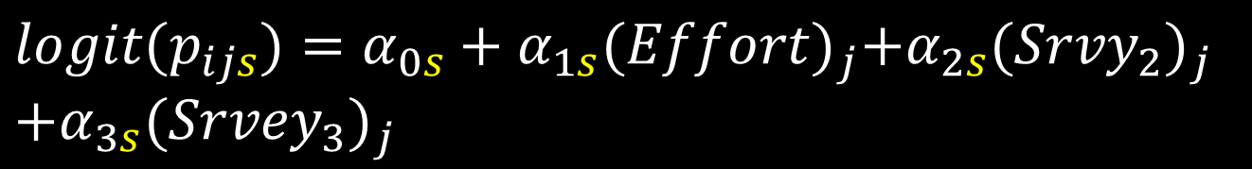



“Multispecies” model
$$y_{ijs}\sim bern(p_{ijs}z_{is})$$
Data
$${logit(p}_{ijs})=α_{0s}+α_{1s}{(Effort)}_{j}+α_{2s}{({Srvy}_{2})}_{j}$$
$$+α_{3s}{({Srvey}_{3})}_{j}$$
$$z_{is}\sim bern(ψ_{i})$$
Process
$${logit(ψ}_{is})=β_{0s}+β_{1s}{(ag)}_{i} + β_{2s}{(urb)}_{i}+ β_{3s}{(mine)}_{i}$$
$$+β_{4s}{(veg)}_{i}+β_{5s}{(size)}_{i}+β_{6s}{(isol)}_{i}+ ε_{is}$$
$$ε_{is}\sim N(0,Σ)$$
$α_{ls}\sim N(0,σ_{α}^{2})$, l = 0,…,3
$$Σ_{ii′}\sim σ^{2}exp\left(\frac{−d_{ii′}}{φ}\right)$$
Parameter
$β_{ks}\sim N(μ_{βk},σ_{βk}^{2})$, k = 0,…,6
$$σ_{βk}^{2}\sim IG(r_{β},q_{β})$$
$$μ_{βk}^{}\sim N(μ_{o},σ_{o}^{2})$$

Slide 11

“Multispecies” model
$$y_{ijs}\sim bern(p_{ijs}z_{is})$$
Data
$${logit(p}_{ijs})=α_{0s}+α_{1s}{(Effort)}_{j}+α_{2s}{(Date)}_{j}$$
$$z_{is}\sim bern(ψ_{i})$$
Process
$${logit(ψ}_{is})=β_{0s}+β_{1s}{(ag)}_{i} + β_{2s}{(urb)}_{i}+ β_{3s}{(mine)}_{i}$$
$$+β_{4s}{(veg)}_{i}+β_{5s}{(size)}_{i}+β_{6s}{(isol)}_{i}+ ε_{is}$$
$$ε_{is}\sim N(0,Σ)$$
$α_{ls}\sim N(0,σ_{α}^{2})$, l = 0,…,3
$$Σ_{ii′}\sim σ^{2}exp\left(\frac{−d_{ii′}}{φ}\right)$$
Parameter
$β_{ks}\sim N(μ_{βk},σ_{βk}^{2})$, k = 0,…,6
$$σ_{βk}^{2}\sim IG(r_{β},q_{β})$$
$$μ_{βk}^{}\sim N(μ_{o},σ_{o}^{2})$$

Slide 12
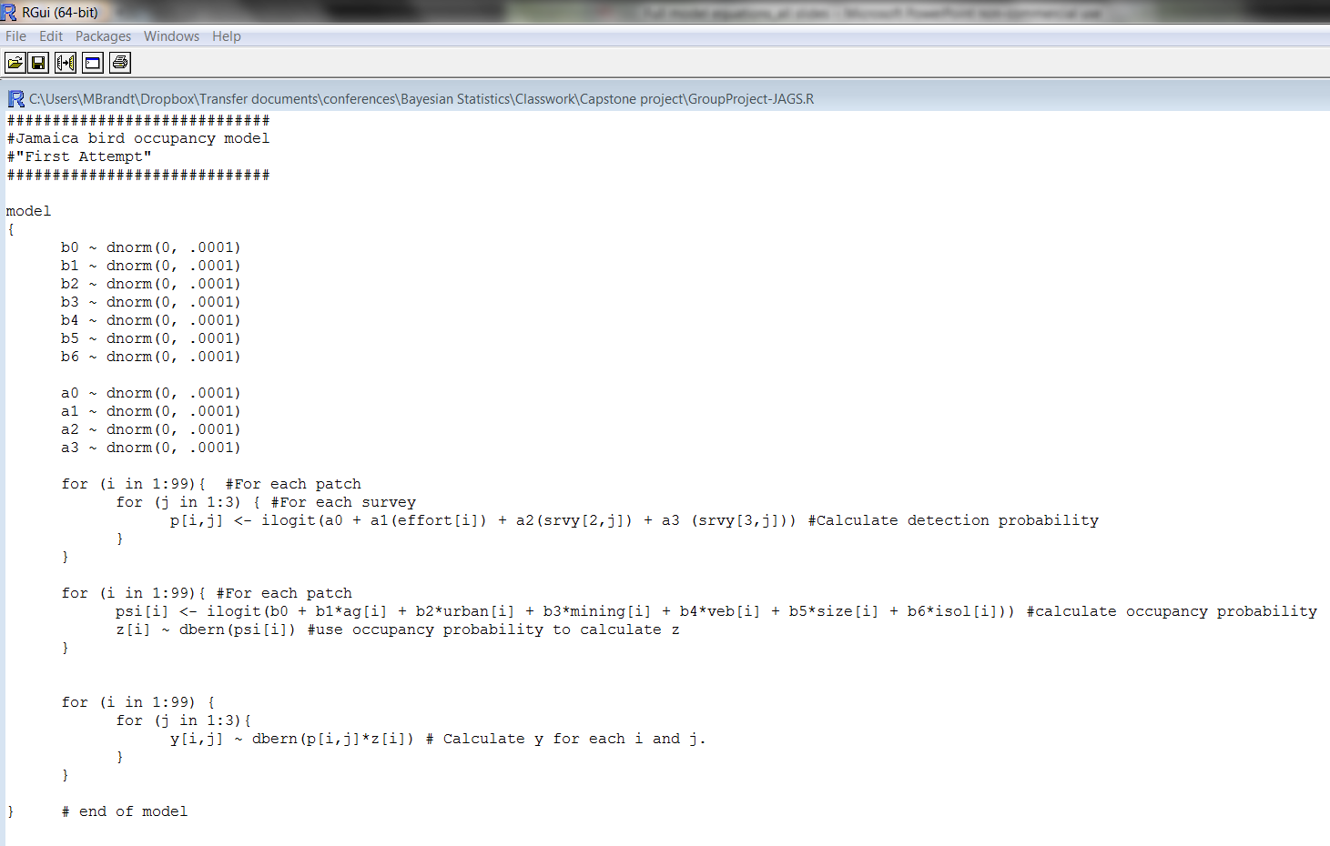
With survey (4 alphas)

Slide 13
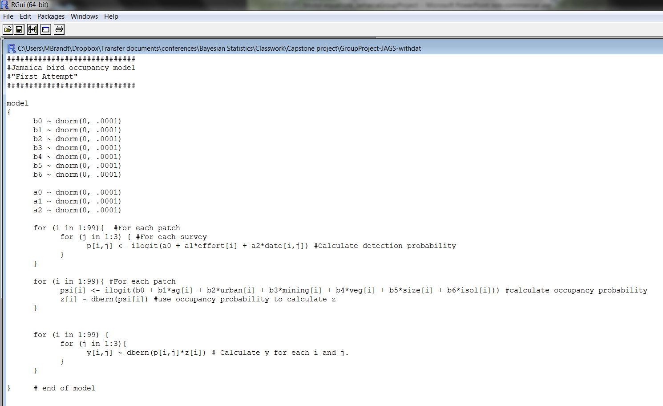
With date (3 alphas)

